Slide 1

Human Face Recognition Attendance System
Group Name: Exception
Group Member:
Farhat Tasnim – 1410482042 - farhat.tasnim@northsouth.edu
K.M.H.Mubin -1621802042 – kmh.mubin@northsouth.edu

Slide 2
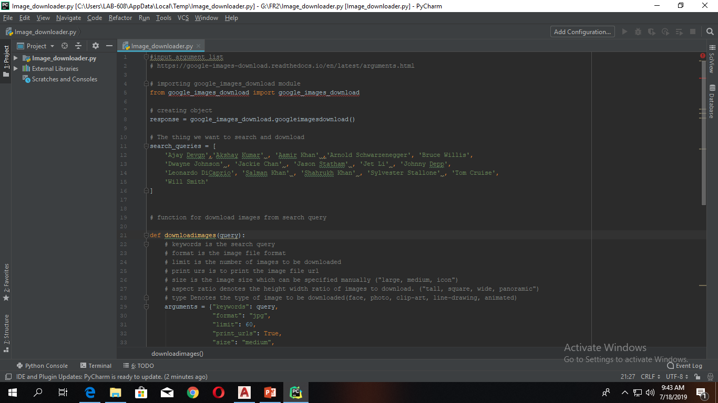
Automatic Image Downloader script
In our project we need to download so many images for train our algorithm. To download more than 100 images its not easy. So solve this problem we build a python script. This script will follow the search query to search and download the images from google search engine.

Slide 3
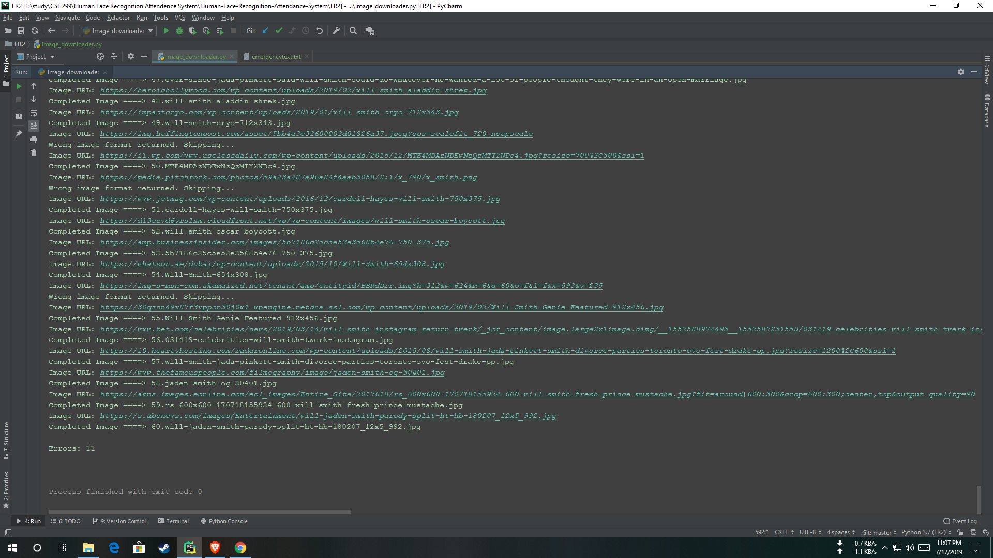
Image downloader result

Slide 4
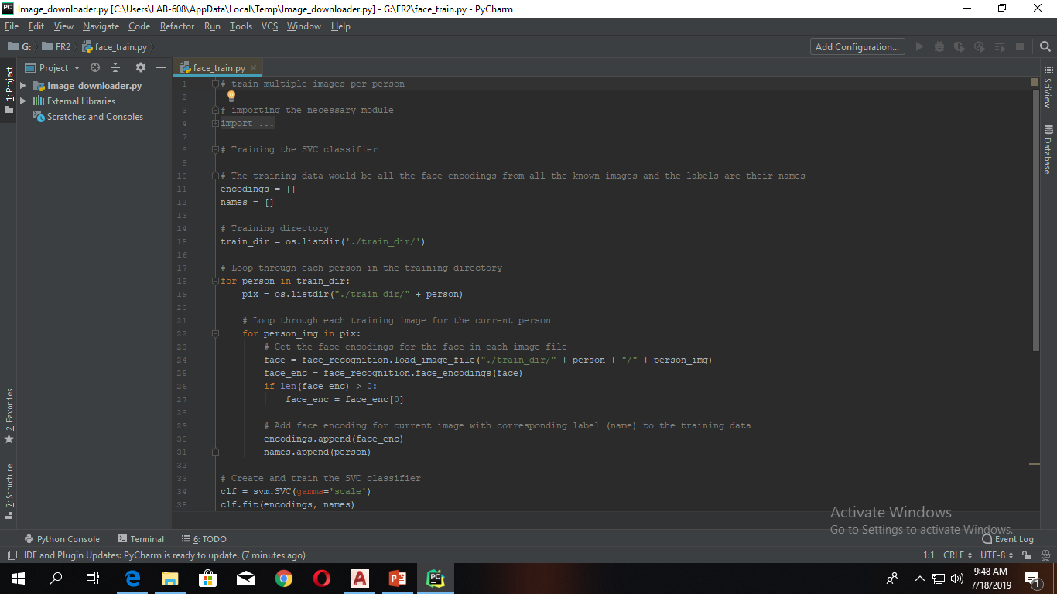
Image trainer

Slide 5
References
Face Recognition with open cv:
https://www.pyimagesearch.com/2018/06/18/face-recognition-with-opencv-python-and-deep-learning/
https://pypi.org/project/face_recognition/
https://towardsdatascience.com/a-guide-to-face-detection-in-python-3eab0f6b9fc1
https://google-images-download.readthedocs.io/en/latest/arguments.html
https://www.docs.opencv.org/2.4/modules/contrib/doc/facerec/facerec_tutorial.html

Slide 6
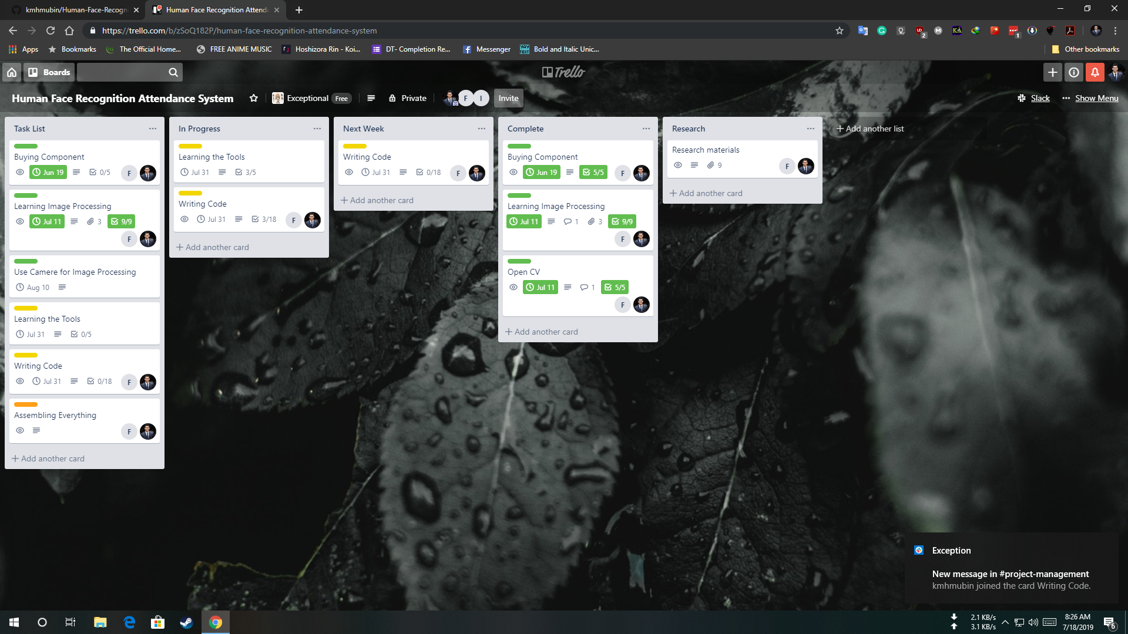
Trello Board

Slide 7
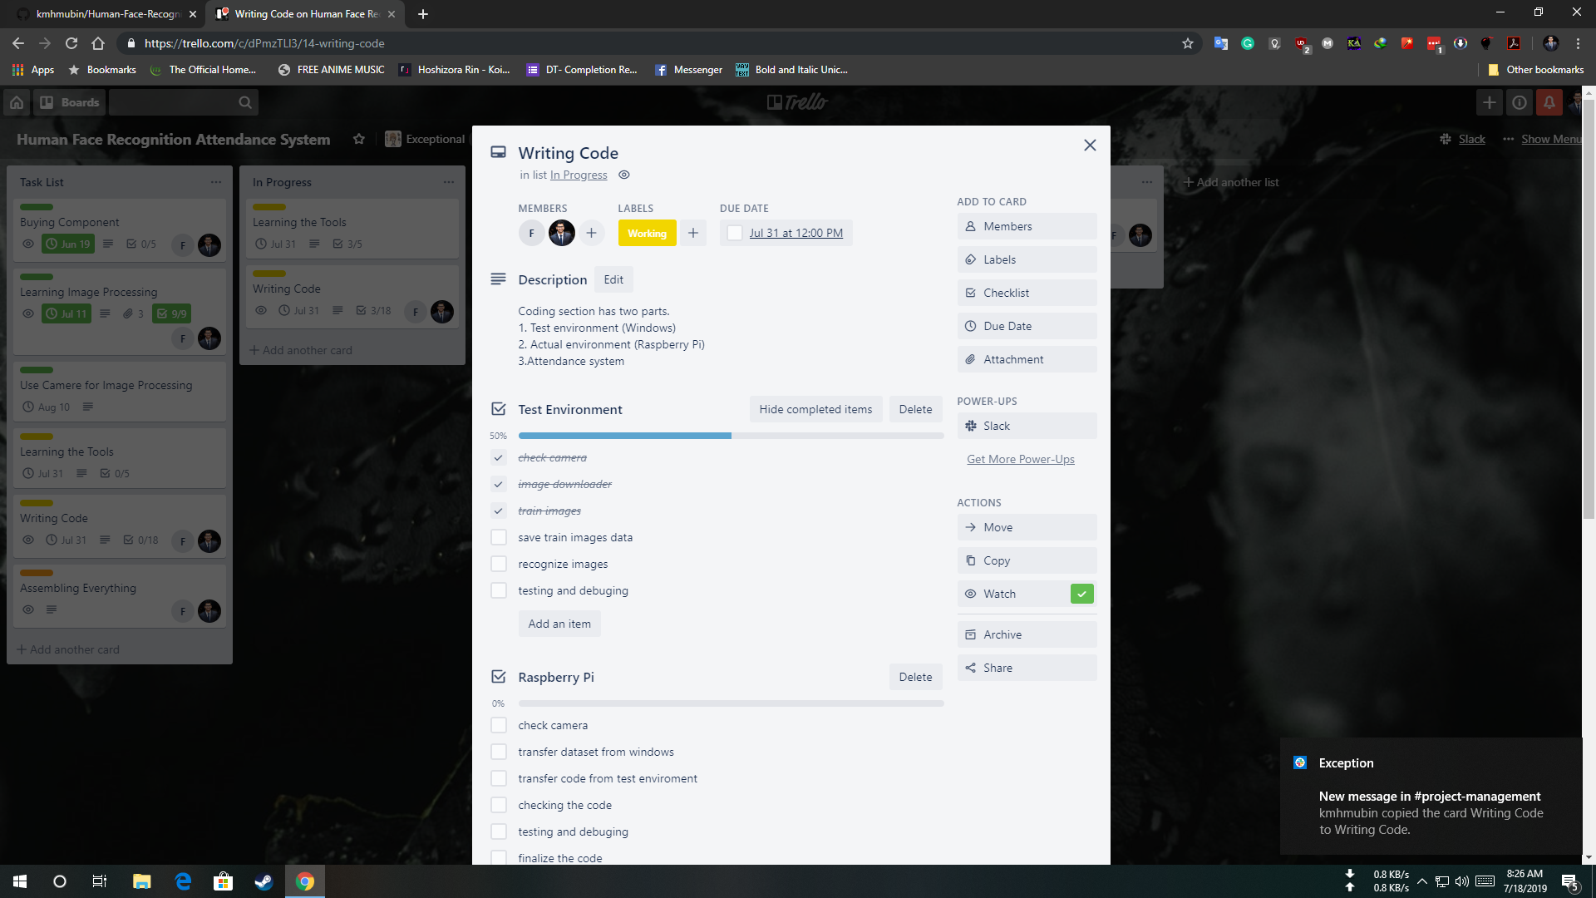

Slide 8
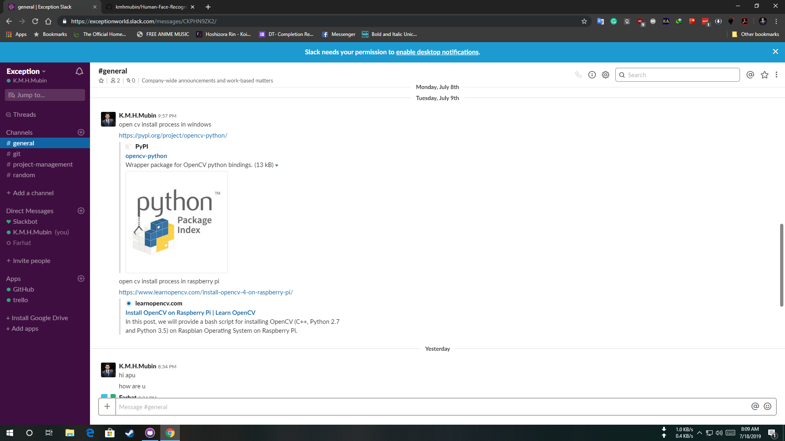
Slack Channel

Slide 9
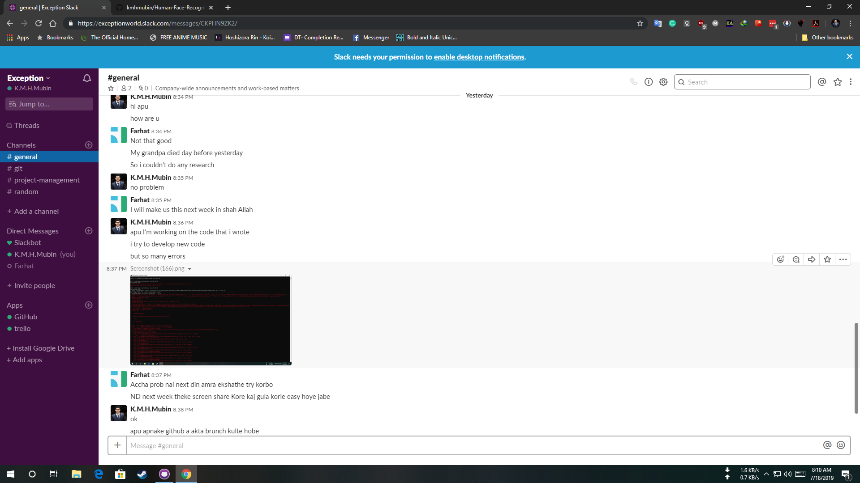

Slide 10
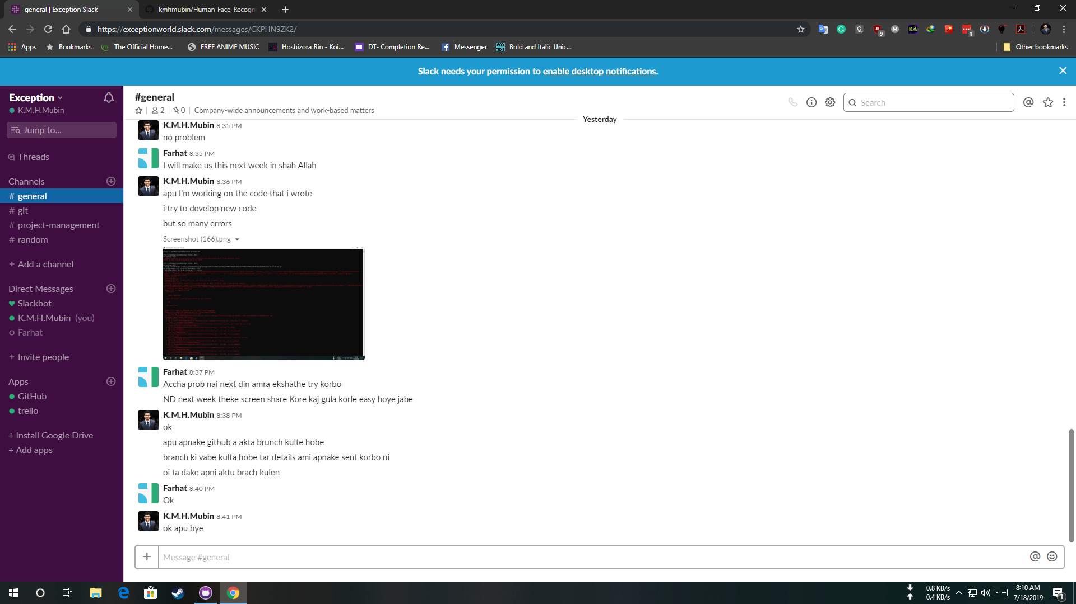

Slide 11
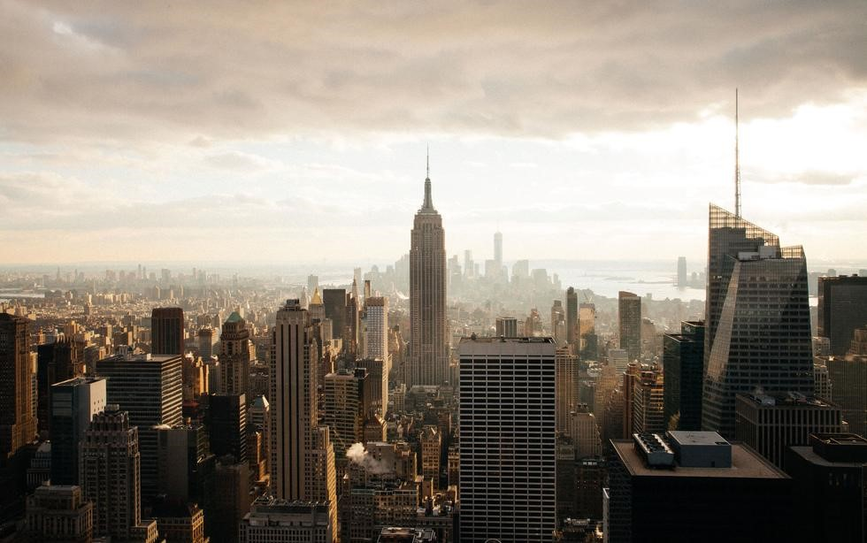






Milestone & TIME FRAME
0%
0%
20%
100%
100%
E
Buying
Products
Image Processing
& apply
Write System
code
Use camera for Image
Processing
Assembling Everything

